Slide 1

Introduction to Machine Learning
13 Juli 2018
Politeknik STTT
Batununggal, Kota Bandung
Markus Paramahasti
(Volantis Technology)

Slide 2
What is Machine Learning ?
Machine ?
Learning ?
Machine Learning ?
Relation with AI ? The differences with AI

Slide 3
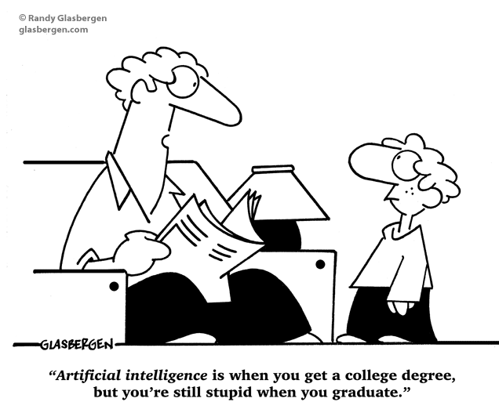

Slide 4
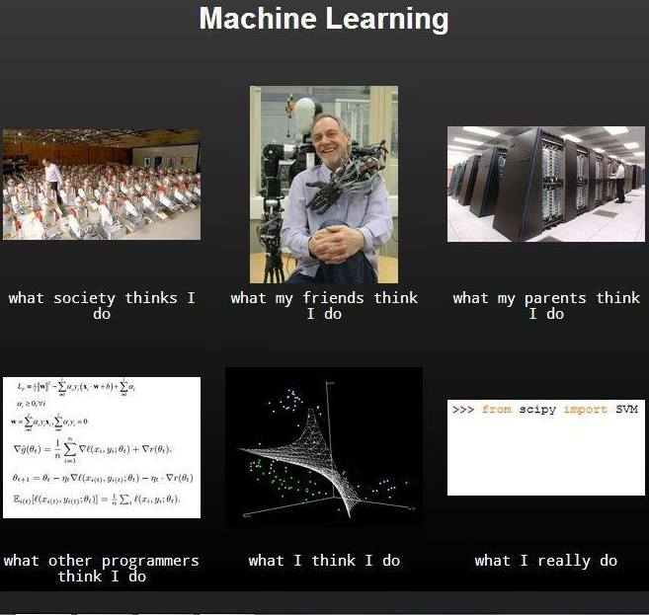

Slide 5
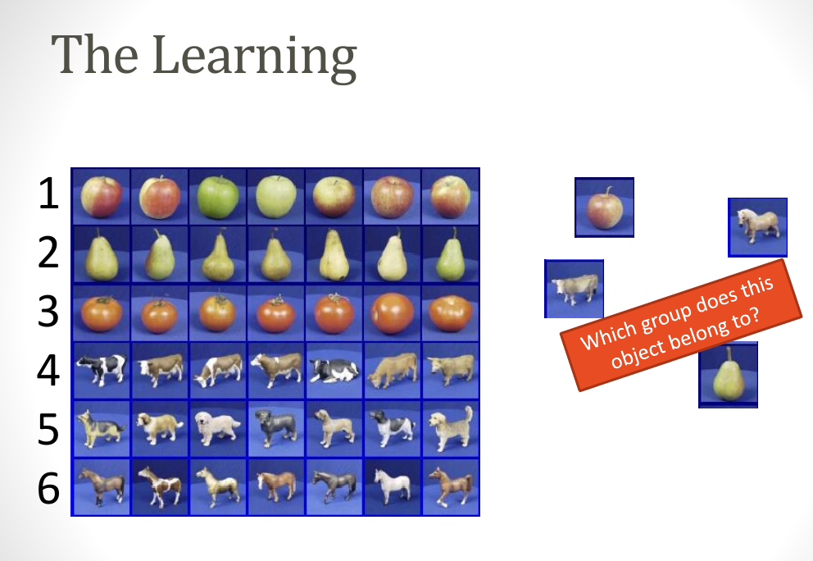
Few Example

Slide 6
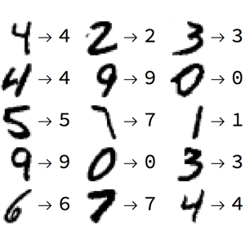
Written Recognition

Slide 7
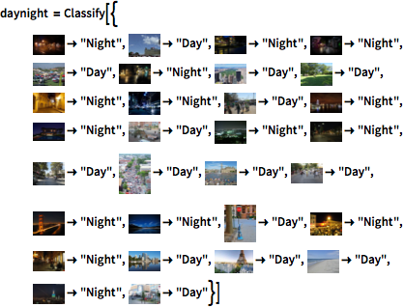

Slide 8
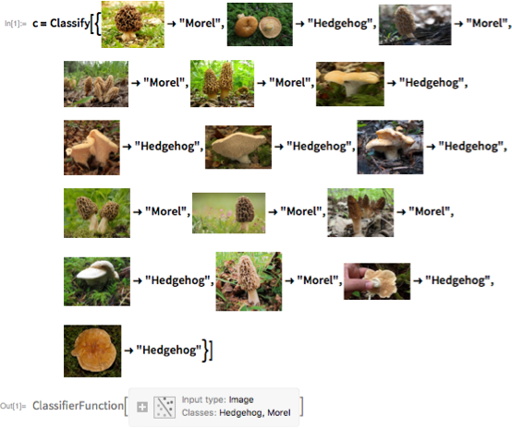

Slide 9
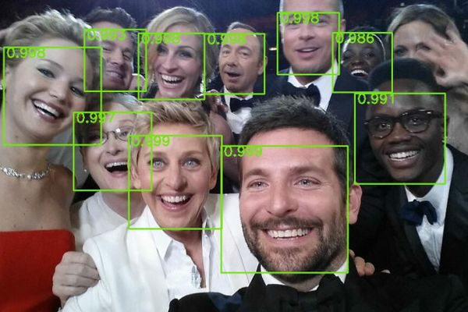

Slide 10
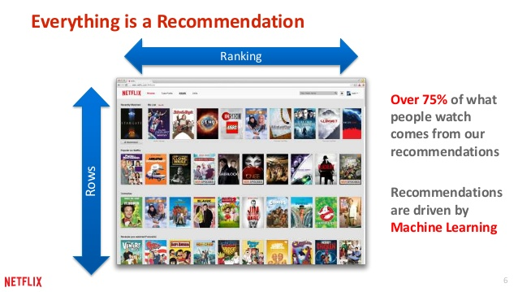

Slide 11
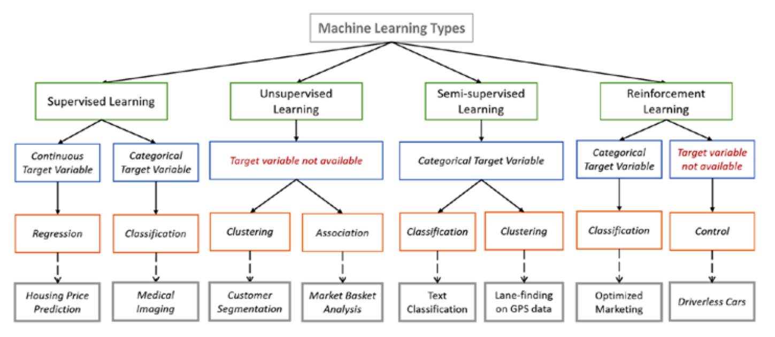
Learning Paradigms

Slide 12
Some Application of ML
https://teachablemachine.withgoogle.com/
https://experiments.withgoogle.com/ai
https://flipboard.com/@flipboard/-new-ai-can-work-out-whether-youre-gay-o/f-a42a3ec94c%2Ftheguardian.com

Slide 13
Prequisites
Mathematical Backgroud : (Theoretical )
Linear Algebra
Basic Statistic and Probability Theory
Programming : (Practical)
Python, R, Matlab, Java, etc.
ML Library e.g. Python (Sci-kit learn, Keras, TensorFlow, etc.) ,

Slide 14
So, What is Machine Learning by the way ?
&
What do we mean by Learning ?

Slide 15
The Definition
Arthur L. Samuel :
“Field of study that gives computers the ability to learn without explicitly being programmed”
Tom M. Mitchell :
“A computer program is said to learn from experience E with respect to class of tasks T and performance measure P, if its performance at task T, as measured by P improve with experience E”

Slide 16
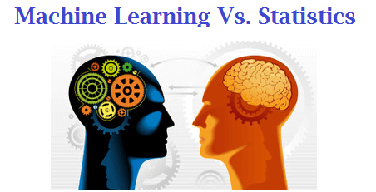
Relation to Statistic

Slide 17
Some Terminology
Statistical Learning (Statisticians)
Statistical Modeling is a formalization of a relationships between variables in the data in the form of mathematical equation.
Machine Learning (Computer Scientists)
ML is an algorithm that can learn from data without relying on rule-based programming.

Slide 18
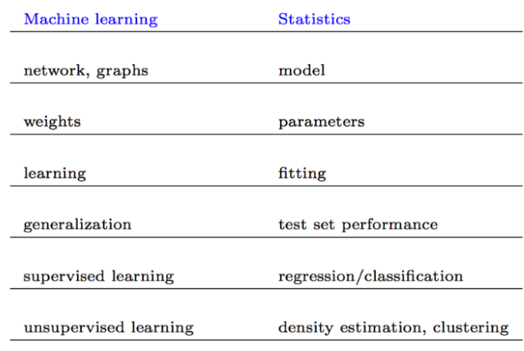
Another Terminology

Slide 19
The Task
For example in Supervised Learning (Classification & Regression)
Classification : an attempt to classify or categorize a data to some class/group/type.
Regression : try to guess a value

Slide 20
When/Why we use ML ?
When :
We can’t code the rules
We can’t scale the task
Lack of human expertise
Why :
Efficient
Prevent human error

Slide 21
Companies that use ML
Google
Amazon
Netflix
Soundhound
Baidu
Pinterest
Kofera
Etc.

Slide 22
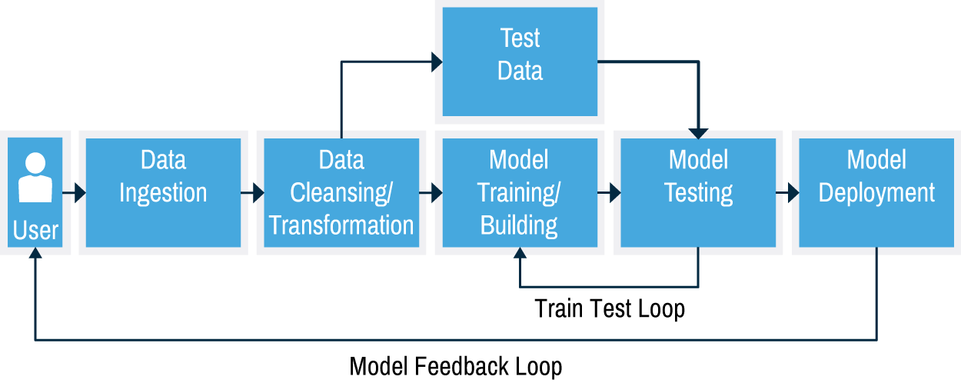
ML Workflow

Slide 23
What is the best model ?
“All models are wong but some model are usefull” – George Box (in Journal of the American Statistical Association)
An ML model as good as your data : “garbage in garbage out”
No free lunch

Slide 24
Okey…! Let’s move to another topic : The Supervised Learning

